Slide 1

DENATL CLINIC MANAGEMENT SYSTEM
Name : Rajkumar G. Shahu
Exam No :
Project Guide : Prof. Hemali Patel

Slide 2

Project Profile :
SARDAR PATEL UNIVERSITY
C. P. Patel F. H. Shah Commerce (Autonomous) Collage
Anand
B.C.A, B.B.A (ITM) & PGDCA Department
BCA Semester - 6 USO6CBCA55 (2023 - 2024)
Full Name | RAJKUMAR GAURANGBHAI SHAHU
Project Title | Dental Clinic Management System
Roll No. | 63
University Exam No.
Front End Tool | ASP.NET With C#
Back End Tool | SQL Server
Project Guide | Prof. Hemali Patel

Slide 3
Index
Sr. No | Description of Topic
1 | Acknowledgement
2 | Introduction To The Project
3 | Scope Of Work
4 | An Existing System
5 | Need of proposed System
6 | Feasibility Study
7 | System Features
8 | Hardware and Software
9 | Data Flow Diagram / OOAD / UML
10 | Database Layout / Data dictionary
11 | Design of Input / Output Screen
12 | Limitations
13 | Proposed Enhancement
14 | Conclusion

Slide 4
Acknoledgement
incomplete without the mention of people whose ceaseless cooperation made it possible, whose constant guidance and encouragement crown all efforts with success.
I am grateful to our project guide “Prof. Hemali Patel” for the guidance, inspiration and constructive suggestion that helpful us in the preparation of this project.
I am also thankful to our Head of The Department “Dr. Nayan Patel” for his continuous guidance.
I am also obliged to our Principal “Dr. R. D. Modi” for creative support.
I also thank my colleagues who have helped in successful completion of the project.

Slide 5
INTRODUCTION TO THE PROJECT
Project Request:
The “Dental Clinic Management System” has been developed to override the problems prevailing in the practicing manual system. This software is supported to eliminate and, in some cases, reduce the hardships faced by this existing system.
Purpose:
Dental clinic management software promotes easy data entry and usage. It includes patient’s personal information, medical and dental history, patient history . This makes your dental practice more convenient, efficient and precise.

Slide 6
Objective of proposed system:
The main objective of proposed system is to manage the details of dental clinic, doctors, patients and appointments. It manages all the information about dental clinic, booking, appointment, dental clinic. It tracks all the details about the patient, test, appointment.
The purpose of project is to build an application program to reduce the manual work for managing the dental clinic, doctors, appointments & patients.

Slide 7
Scope of Work
It may help collecting perfect management in details. In a very short time, the collecting will be obvious, simple and sensible.
It will help a person to know the management of passed year perfectly. It also helps in current all works relative to dental clinic management system. It will be also reducing the cost of collecting the management and collection procedure will go on smoothly.
The system generated types of information that can be used for various purpose:
• Utilize resources in an efficient manner by increasing their productivity.
• It satisfies the user requirement.
• Be easy to understand by the user and operator.
• Be easy to operate.
• Have a good user interface.

Slide 8
An Existing System
An existing system is based on manual work and all the process are done manually, so they maintain register and files for recording all to details of the system.
The existing system maintains all the records like patient information. They have to maintain a special register to maintain the patient details including their names, address and contect number etc.
The aim is to automate is existing manual system by the help of computerized equipment’s fulfilling their requirements, so that their valuable data can be stored for a longer period with easy accessing and manipulation of the same.

Slide 9
Problem Identification
The old manual system was suffering from a series of drawbacks. Since whole of the system was to be maintained with hands the process of keeping, maintaining and retrieving the information was very tedious and lengthy. The records were never used to be in a systematic order.
The reason behind it is that there is lot of information to be maintained and have to be kept in mind while running the business.
The phase of system analysis process deals with problems which are affecting in the current manual system. The problems are those which are affecting the manual system in its daily routine work.

Slide 10
The problems faced by existing system are described as below:
Difficulty in maintenance of records.
Time Consuming.
No security of data.
Lack of efficiency and man power.
High data redundancy.
Data inconsistency.

Slide 11
Need of Propose System
System needs store information about new entry of dental clinic.
System needs to help the internal staff to keep information of doctor and find them as per various queries.
To maintain quantity records. To keep the record of patient.
System needs to update and delete the record.
Need a search area and also needs a security system to prevent data.

Slide 12
Feasibility Study
After doing the project dental clinic management system, study and analyzing all the existing or required functionalities of the system the next task is to do the feasibility study for the project.
The proposed solution satisfies all the user requirements and should be flexible enough so that future changes can be easily alone based on the future upcoming requirements.

Slide 13
System Futures
Product and Component based.
Creating and changing issues at ease.
Query issue list to any depth. Simple status and resolution.
Multi-level priorities and severities. It contains better storage capacity. Accuracy in work.
Easy and fast retrieval of information.
Well-designed reports.
Access of any information individually.
Work becomes very speedy. Easy to update information.

Slide 14
Hardware and Software
Minimum Hardware Specification for Developer :
Minimum Software Specification for Developer :
Processor | Intel(R)core(TM)2 Duo CPU @2.93 GHz
RAM | 2 GB
Storage | 10 GB
System Type | 32 - bit Operating System
Front-End Tool | ASP.Net With C#
Back-End Tool | SQL SERVER
Operating System | Window 7
Web Browser | Any Web Browser

Slide 15
Minimum Hardware Specification for User :
Minimum Software Specification for User :
RAM | 2 GB
Storage | 10 GB
Operating System | Window 7
Web Browser | Any Web Browser

Slide 16
Data Flow Diagram [DFD]
I used data flow diagram to documents the system. DFDs document a system in a hierarchical manner and the diagramin figure represents the highest level. The diagram is called a context diagram because it represents the system in the context of its environment.
DFD Elements :
A DFD needs to be simple because a user has to go through it, understand it, and suggest correction or changes.A data flow diagram user only four elements.
Process
Externalentity
Dataflow
Data

Slide 17
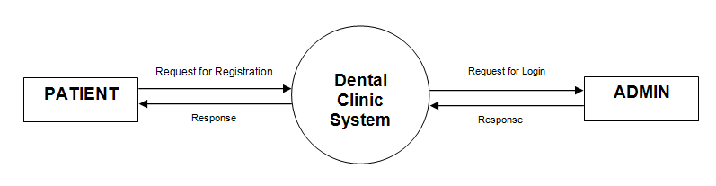
Context Level DFD :

Slide 18
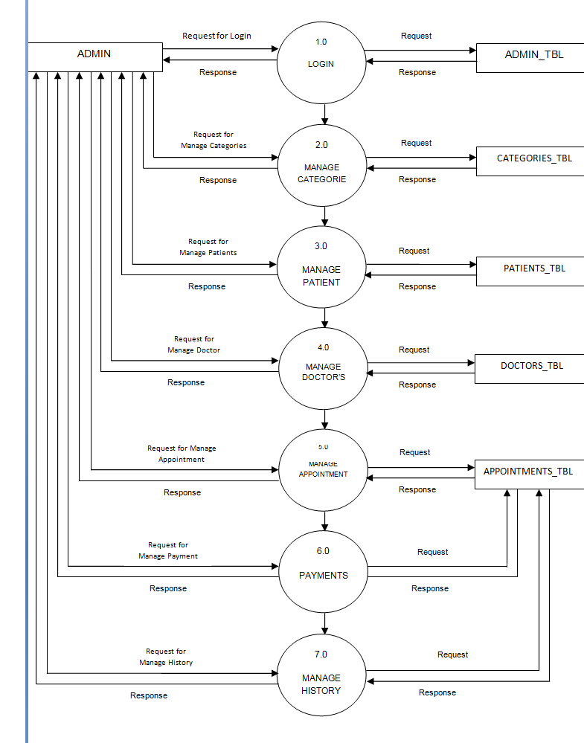
Zero Level DFD For Admin side.
SERVICES_TBL
DENTIST_TBL
APPOINT_TBL

Slide 19
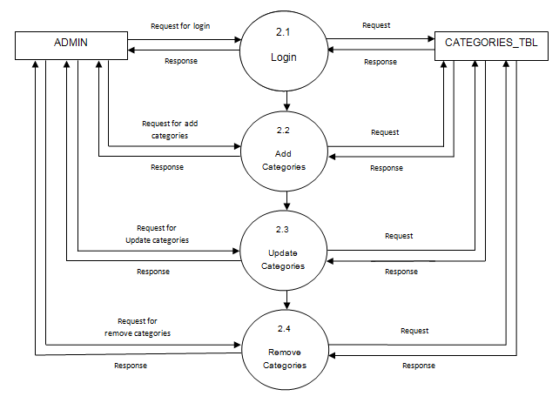
First Level DFD For Admin side (Process 2).
SERVICES_TBL

Slide 20
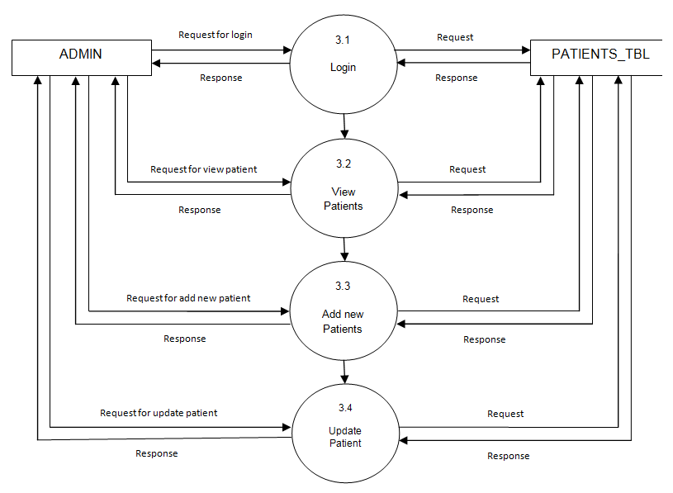
First Level DFD For Admin side (Process 3).

Slide 21
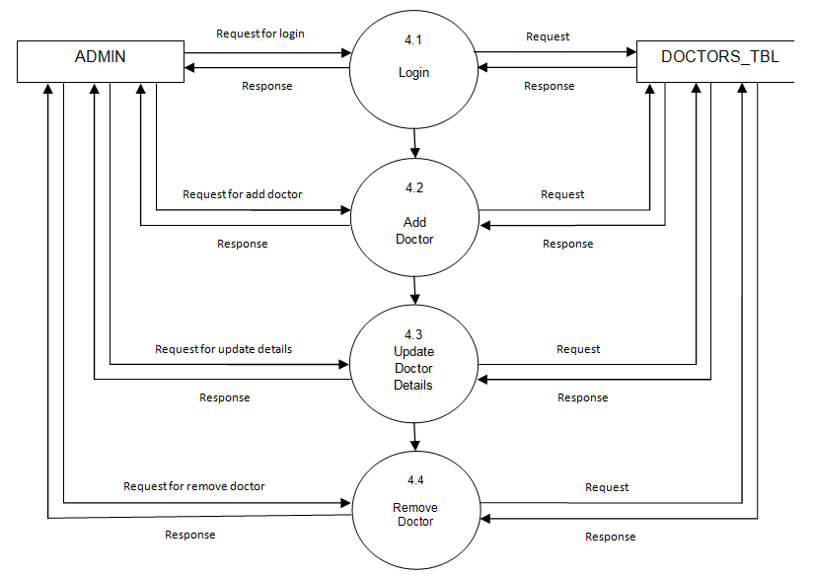
First Level DFD For Admin side (Process4).
DENTIST_TBL

Slide 22
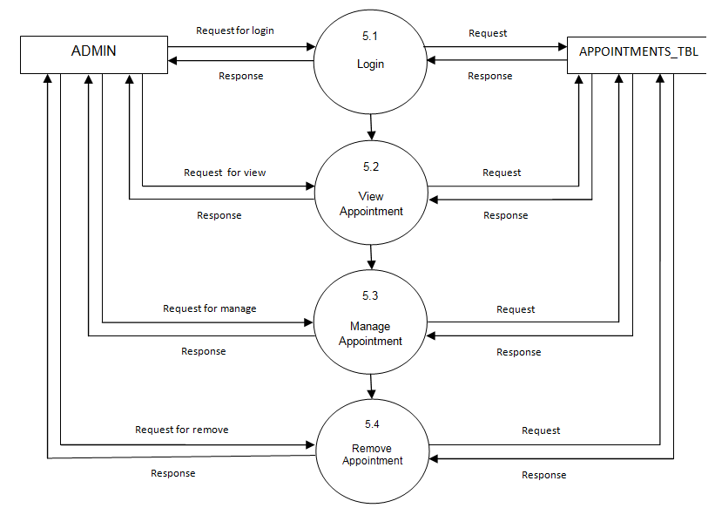
First Level DFD For Admin side (Process 5).
APPOINT_TBL

Slide 23
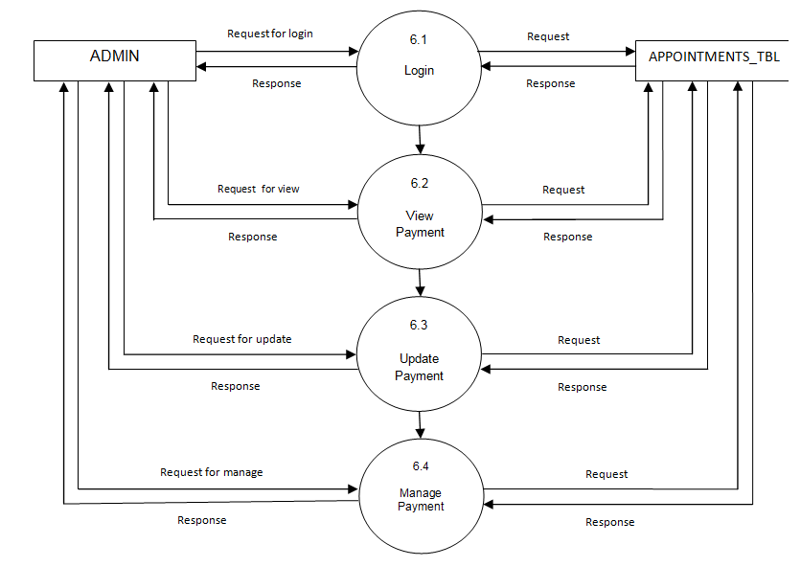
First Level DFD For Admin side (Process 6).
APPOINT_TBL

Slide 24
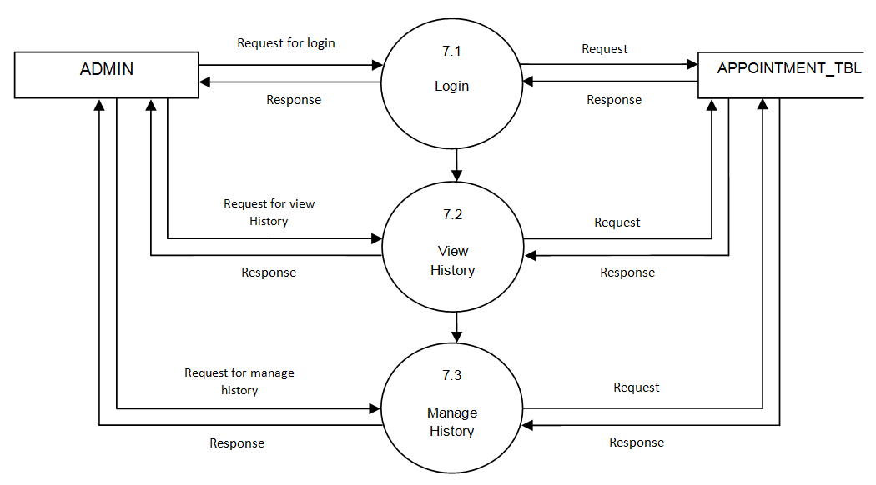
First Level DFD For Admin side (Process 7).
APPOINT_TBL

Slide 25
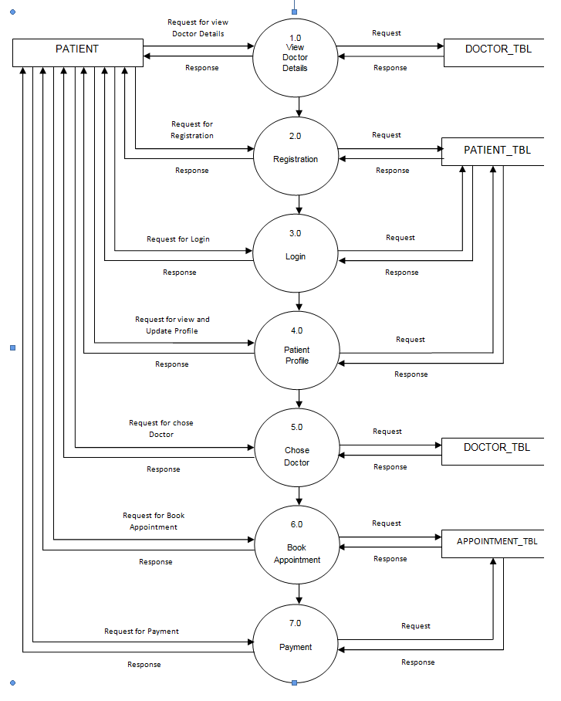
Zero Level DFD For Patient Side.
DENTIST_TBL
DENTIST_TBL
APPOINT_TBL

Slide 26
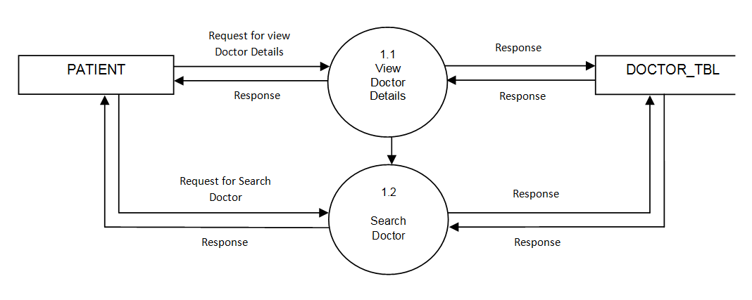
First Level DFD For Patient side (Process 1).
DENTIST_TBL

Slide 27
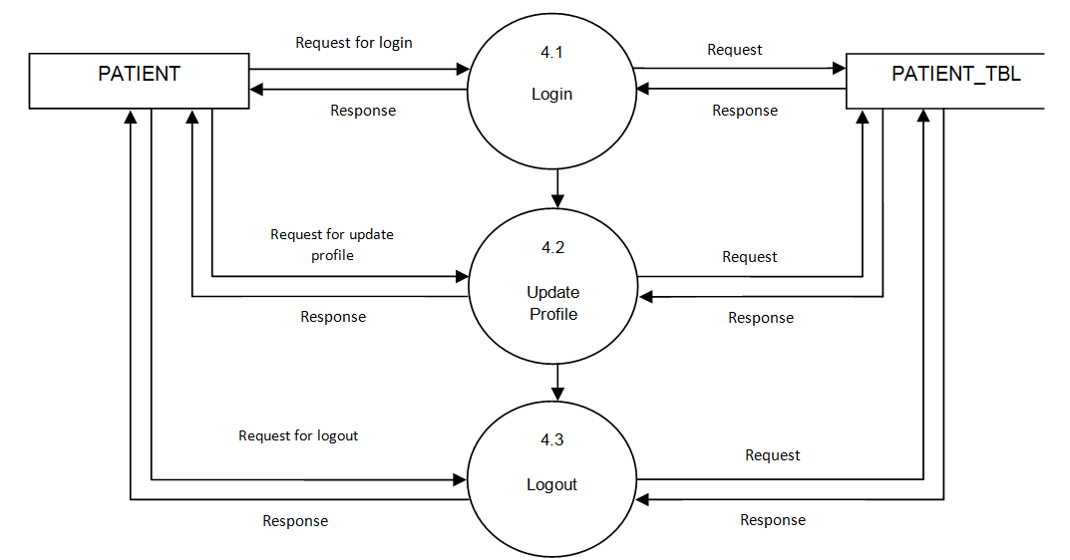
First Level DFD For Patient side (Process 4).

Slide 28
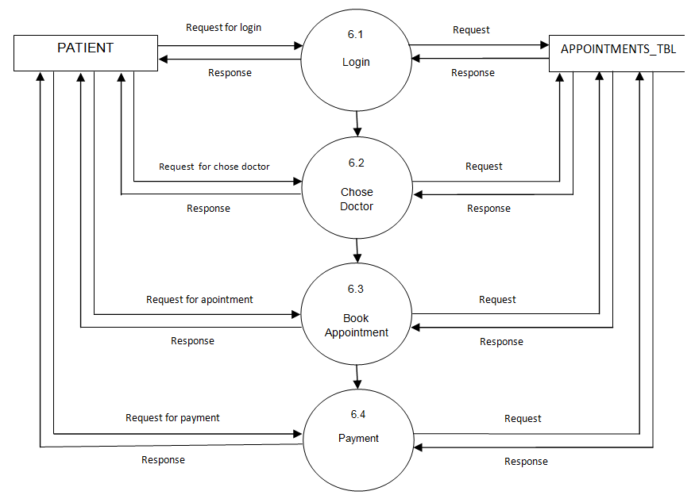
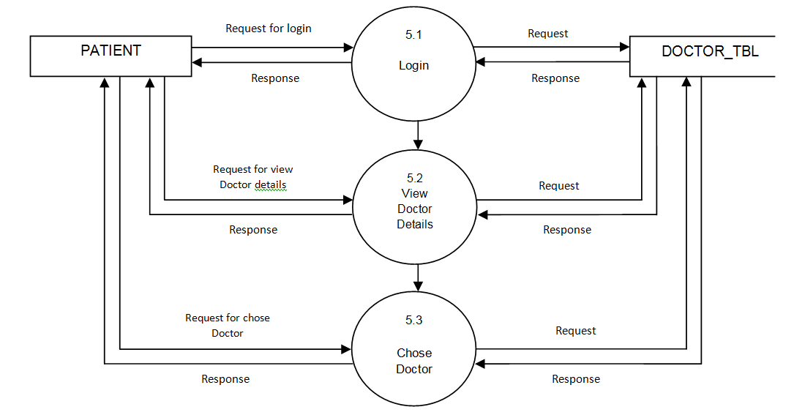
First Level DFD For Patient side (Process 5).
DENTIST_TBL

Slide 29
First Level DFD For Patient side (Process 6).
APPOINT_TBL

Slide 30
Database Layout
ADMIN_TBL :
DENTIST_TBL :
Field Name | Data Type | Constrain
ADMIN_ID | int | Primary Key
ADMIN_NAME | Varchar(30) | Not Null
EMAIL-ID | Varchar(30) | Check
PASSWORD | Varchar(10) | Not Null
PHONE_NO | Numeric(10) | Not Null
Field Name | Data Type | Constrain
D_ID | int | Primary Key
D_NAME | varchar(20) | Not Null
DEGREE | varchar(10) | Not Null

Slide 31
PATIENT_TBL :
Field Name | Data Type | Constrain
P_ID | int | Not Null
P_NAME | varchar(30) | Not Null
AGE | numeric(2) | Not Null
GENDER | varchar(10) | Not Null
PHONE_NO | numeric(10) | Not Null
EMAIL_ID | varchar(30) | Primary key
PASSWORD | varchar(10) | Not Null
ADDRESS | varchar(50) | Not Null
CITY | varchar(10) | Not Null
PINCODE | numeric(6) | Not Null

Slide 32
SERVICES_TBL :
APPOINT_TBL :
Field Name | Data Type | Constrain
ID | int | Primary Key
SERVICE_NAME | varchar(30) | Not Null
Field Name | Data Type | Constrain
P_ID | int | Not Null
P_NAME | varchar(30) | Not Null
AGE | numeric(2) | Not Null
GENDER | varchar(10) | Not Null
PHONE_NO | numeric(10) | Not Null
EMAIL_ID | varchar(30) | Primary key
PASSWORD | varchar(10) | Not Null
ADDRESS | varchar(50) | Not Null
CITY | varchar(10) | Not Null

Slide 33
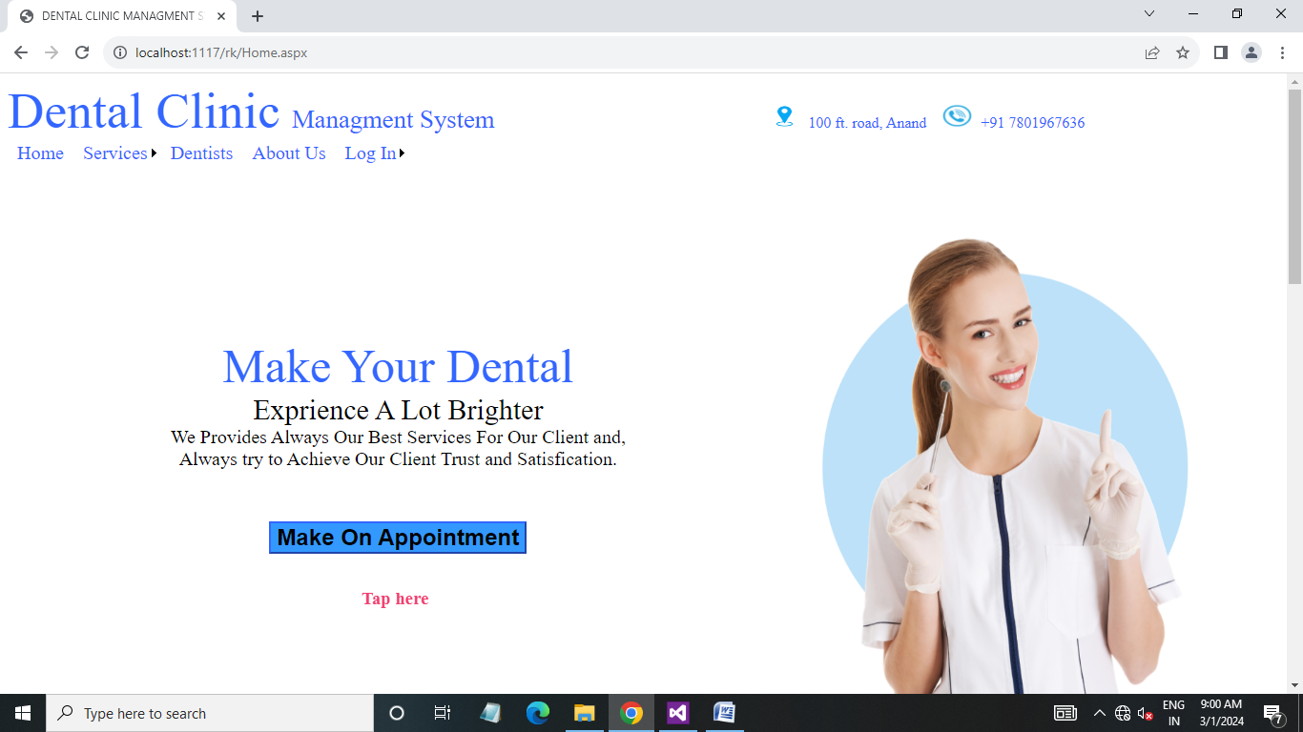
Home page (Patient side) :

Slide 34
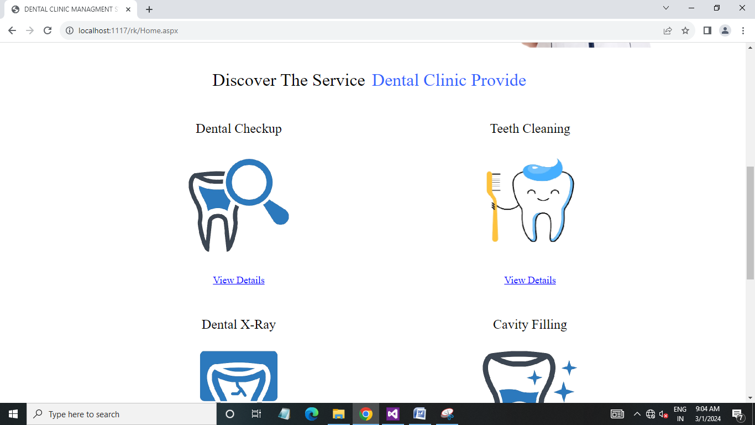
Home page (Patient side) :

Slide 35
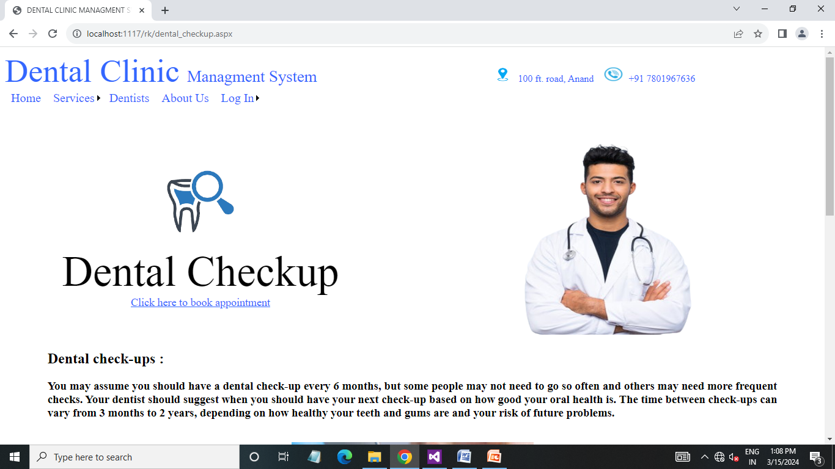
Services page (Patient side) :

Slide 36
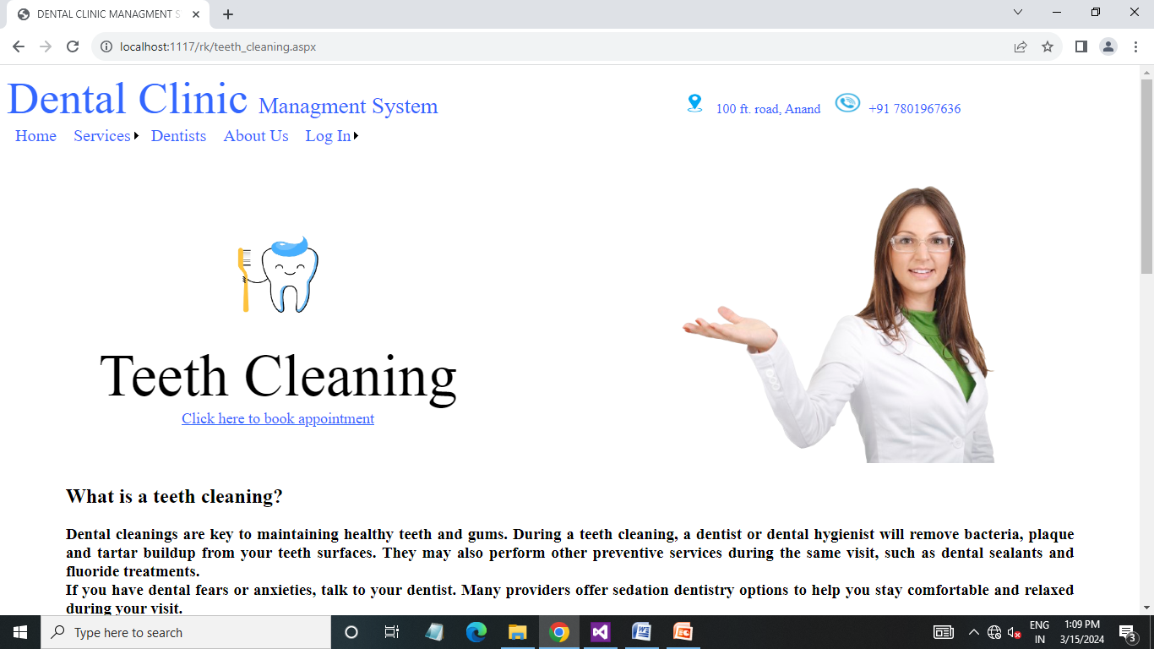
Services page (Patient side) :

Slide 37
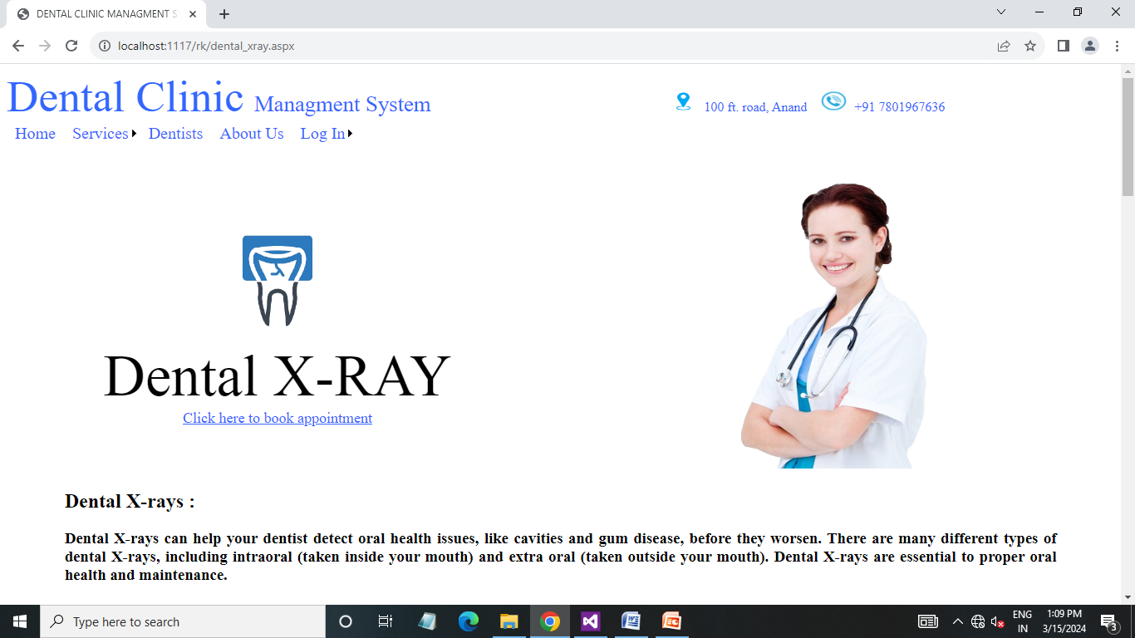
Services page (Patient side) :

Slide 38
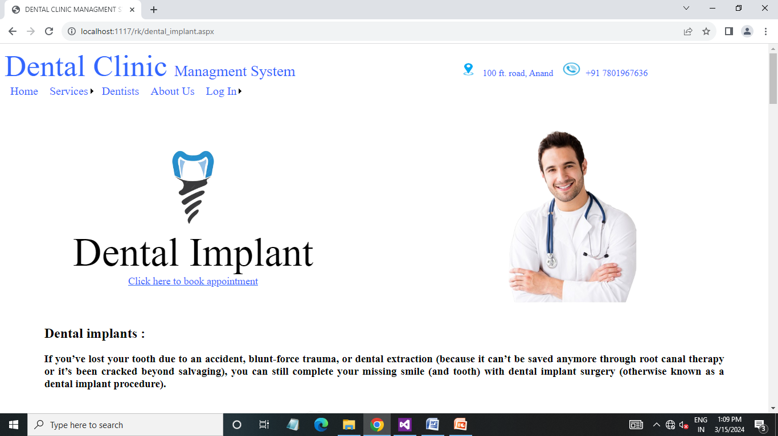
Services page (Patient side) :

Slide 39
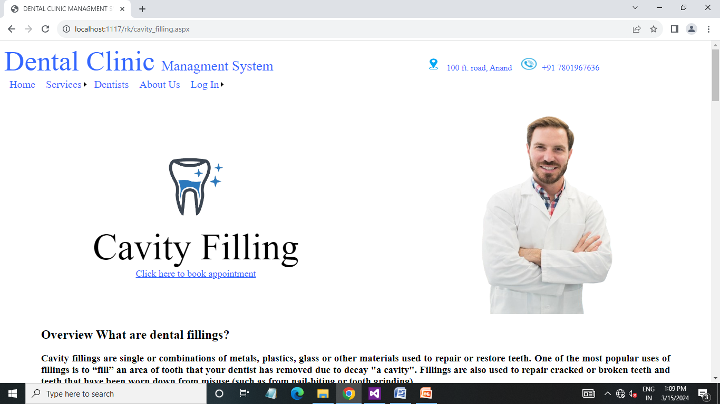
Services page (Patient side) :

Slide 40
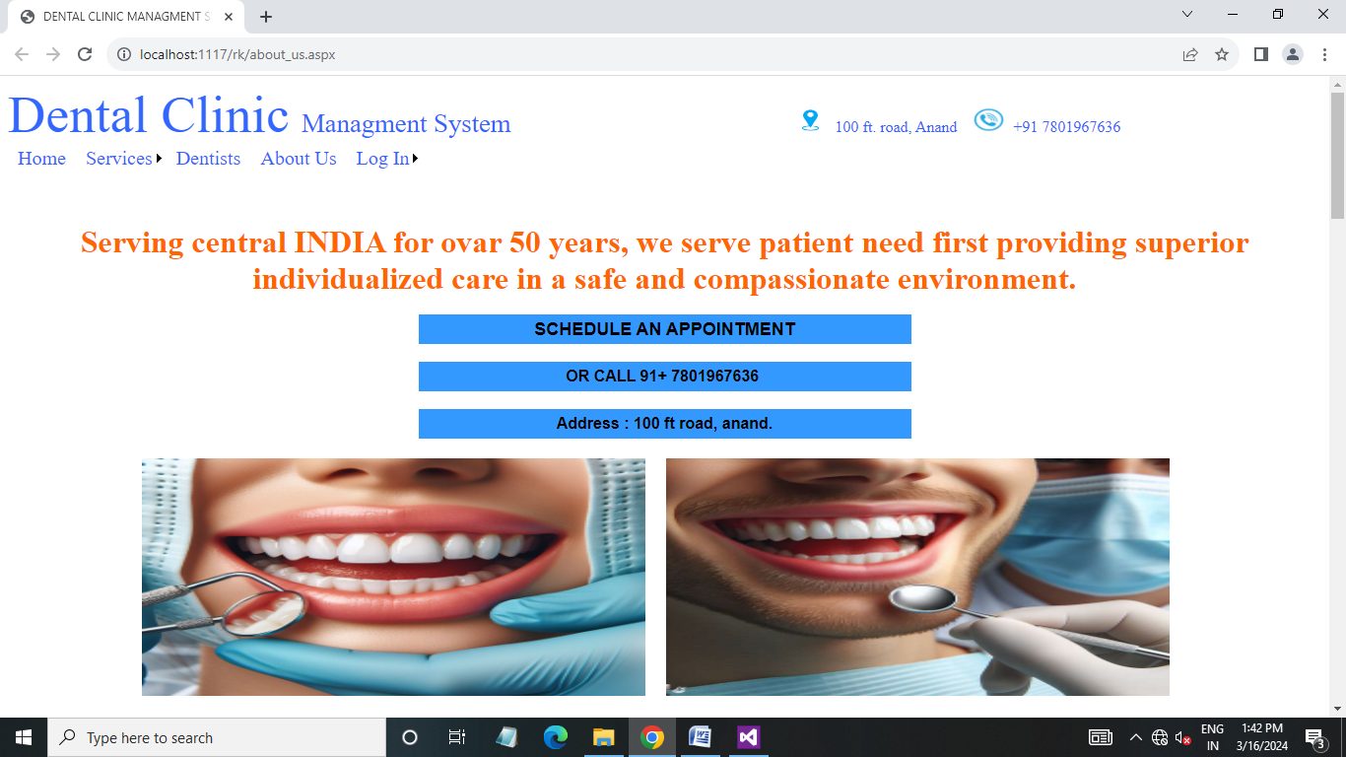
About us page (Patient side) :

Slide 41
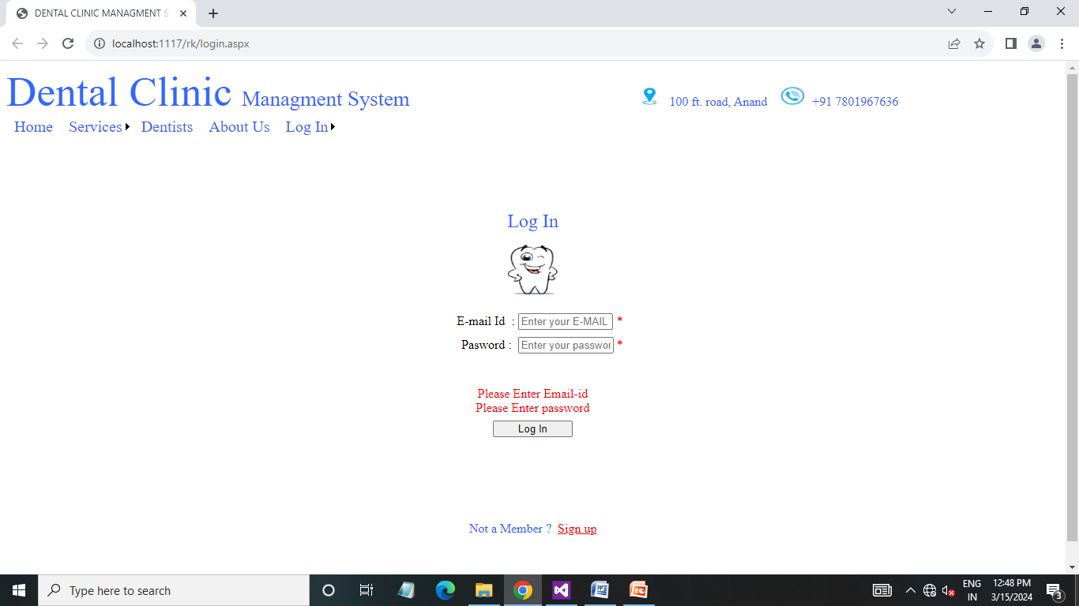
Login page (Patient side) :

Slide 42
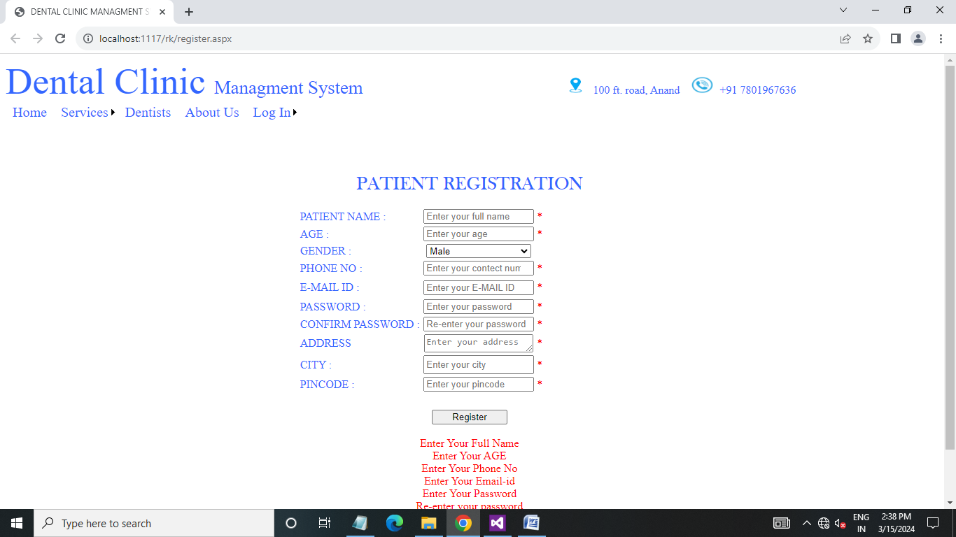
Registration page (Patient side) :

Slide 43
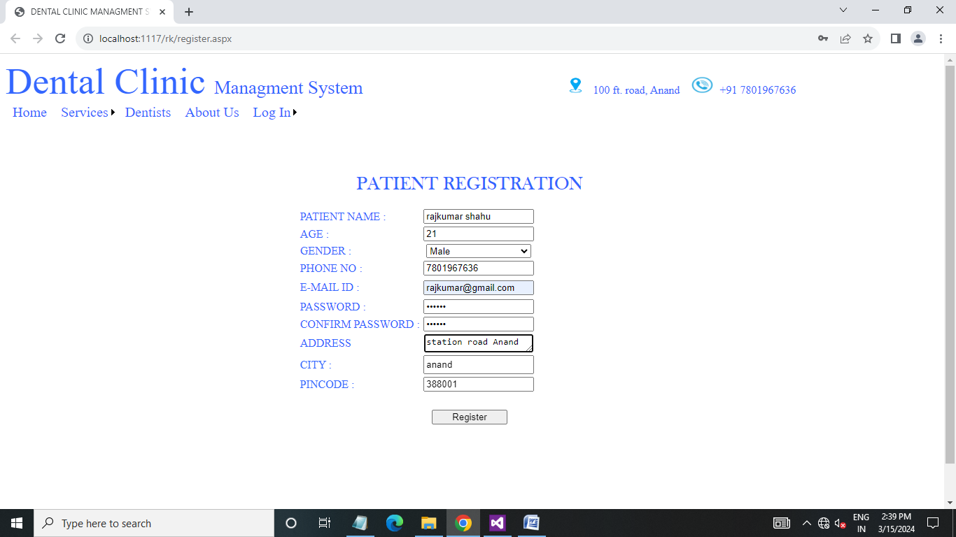
Registration page (Patient side) :

Slide 44
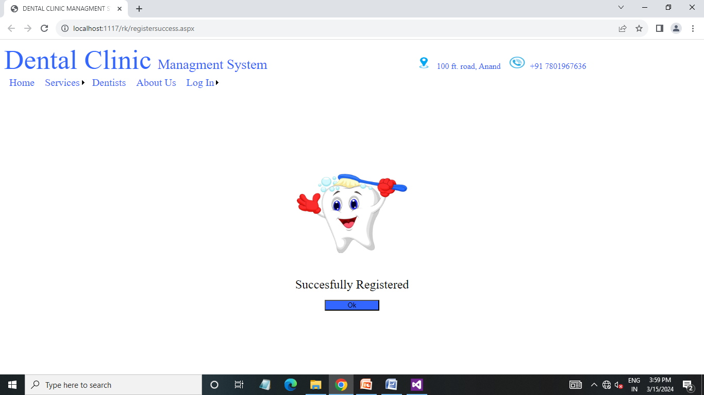
Registration success page (Patient side) :

Slide 45
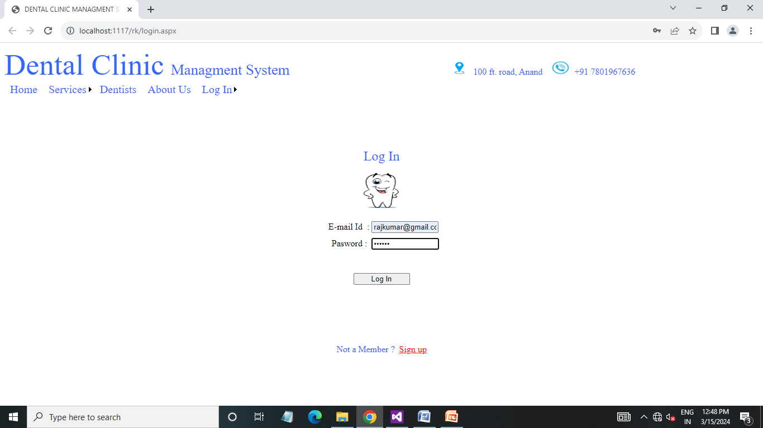
Login page (Patient side) :

Slide 46
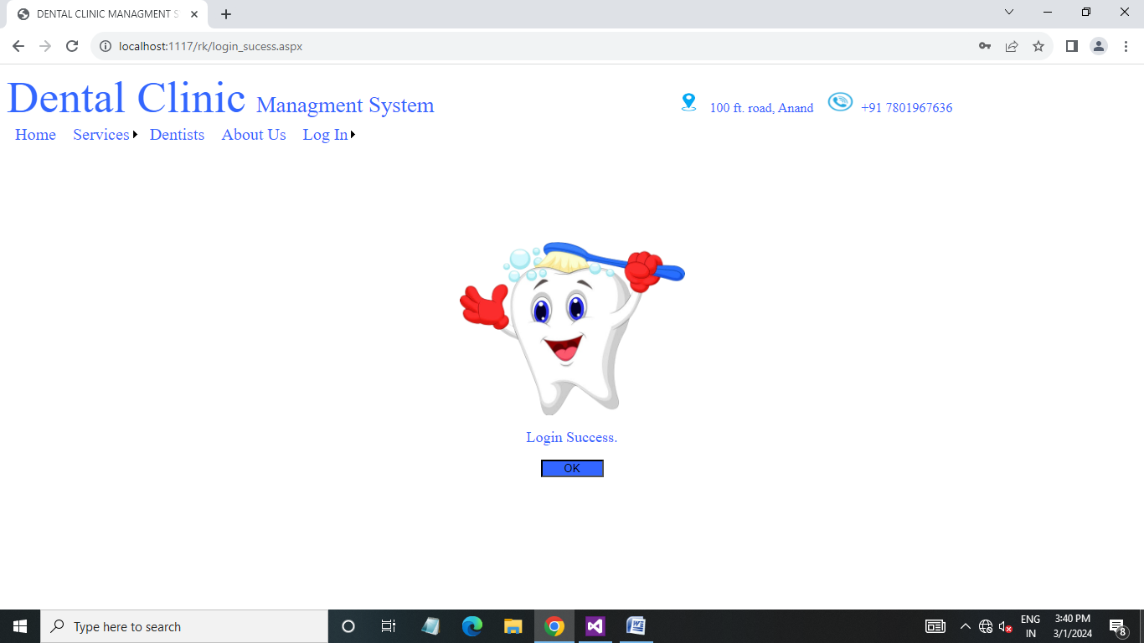
Login success page (Patient side) :

Slide 47
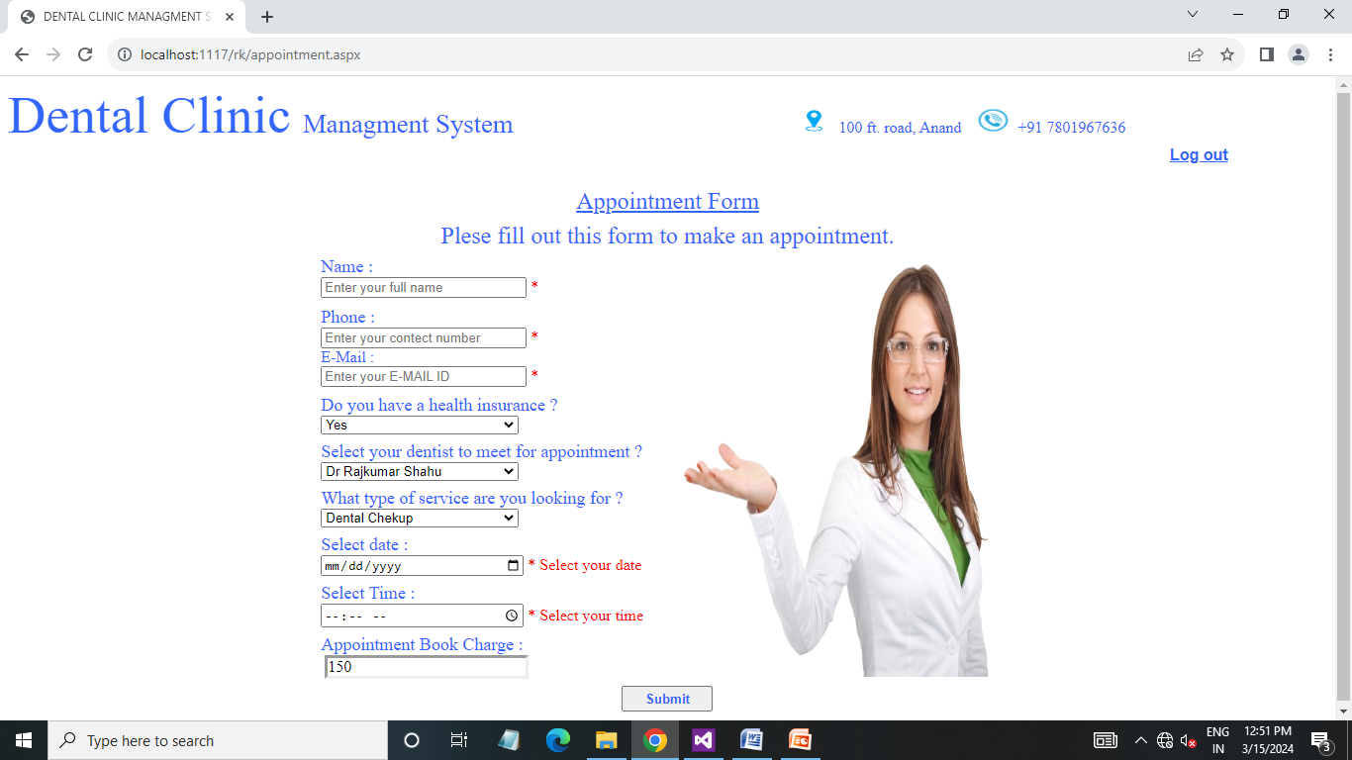
Appointment page (Patient side) :

Slide 48
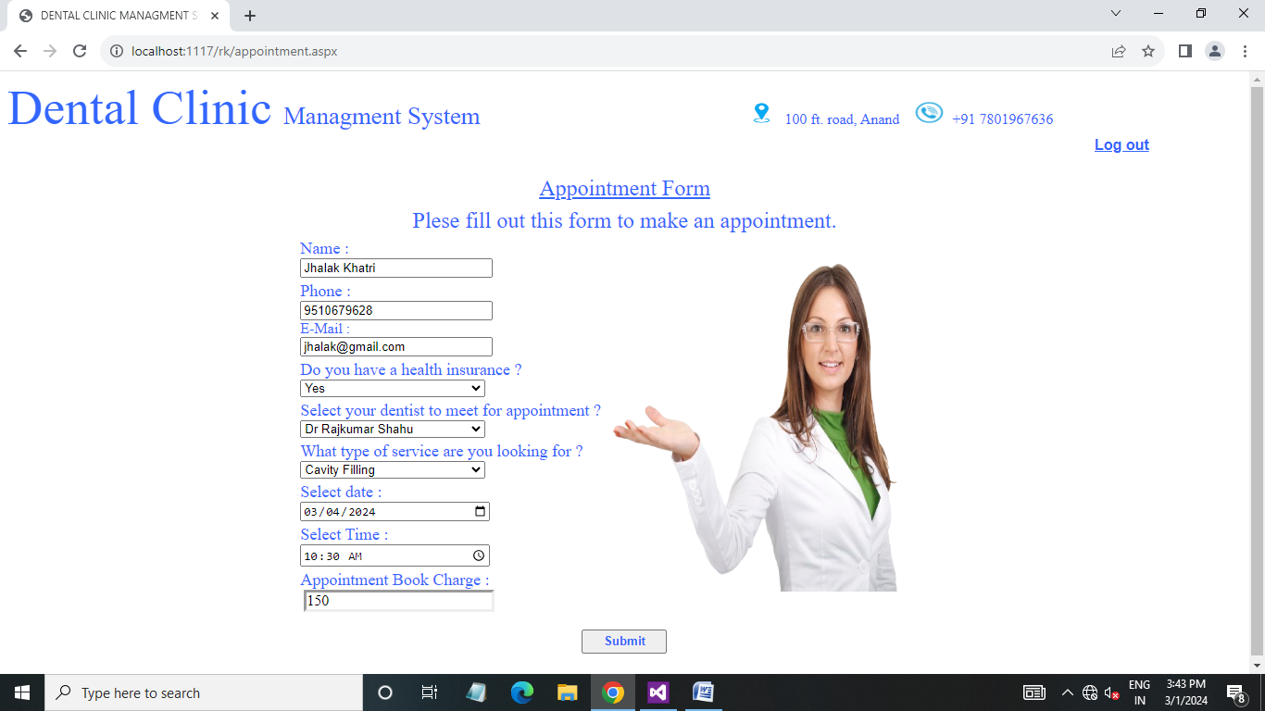
Appointment page (Patient side) :

Slide 49
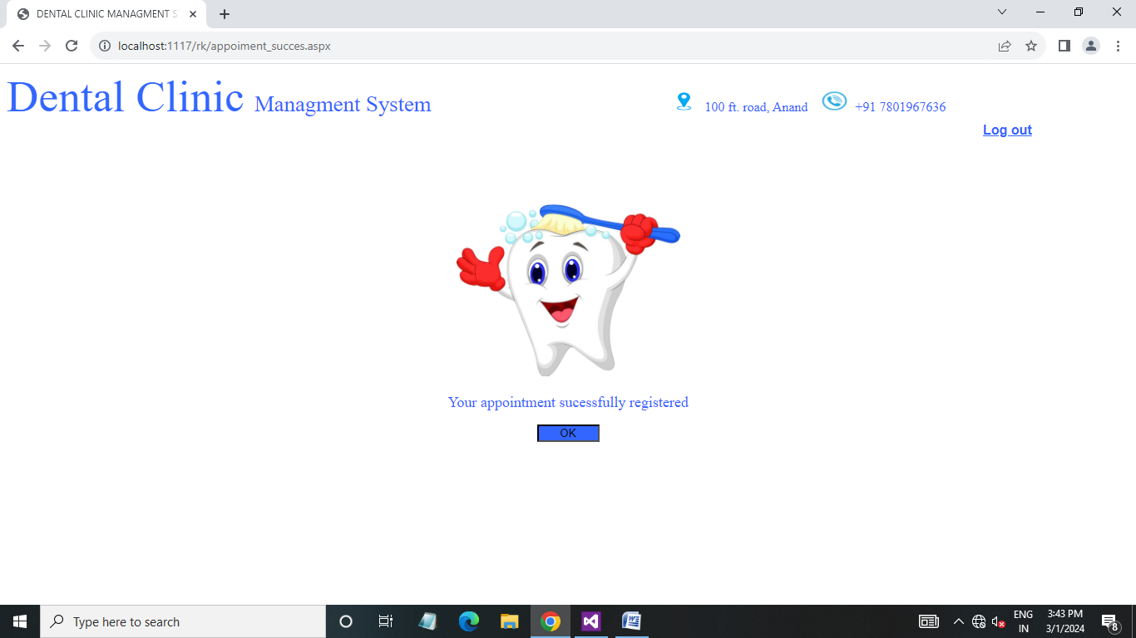
Appointment Book Success page (Patient side) :

Slide 50
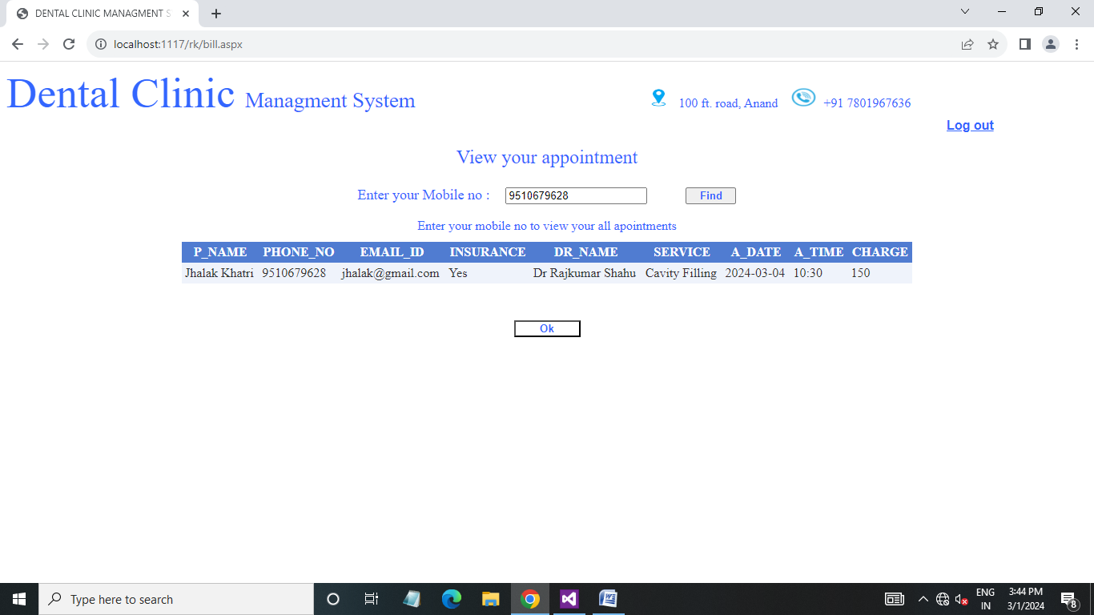
View appointment page (Patient side) :

Slide 51
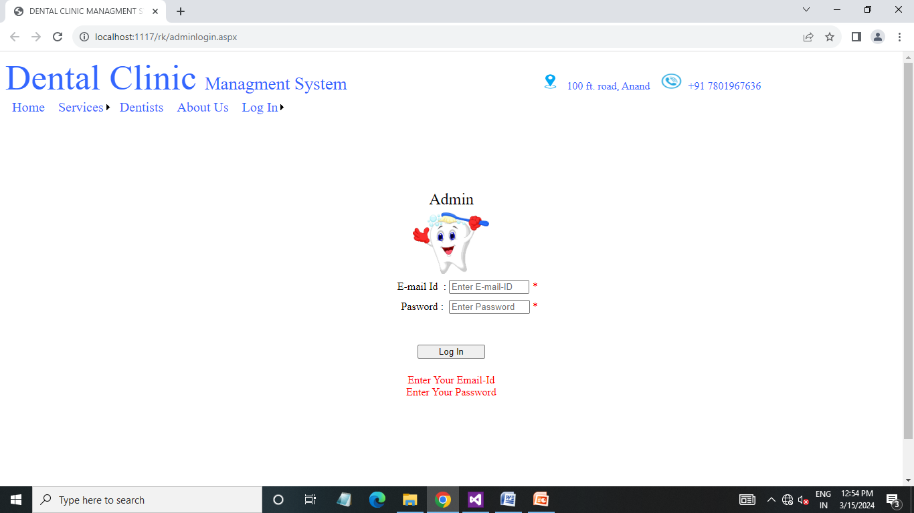
Admin login page (Admin side) :

Slide 52
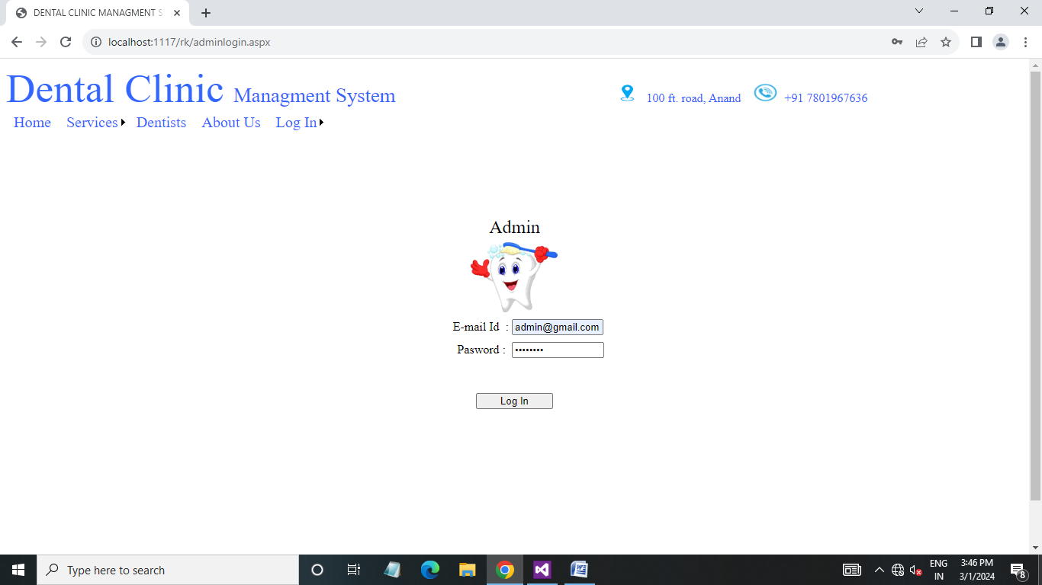
Admin login page (Admin side) :

Slide 53
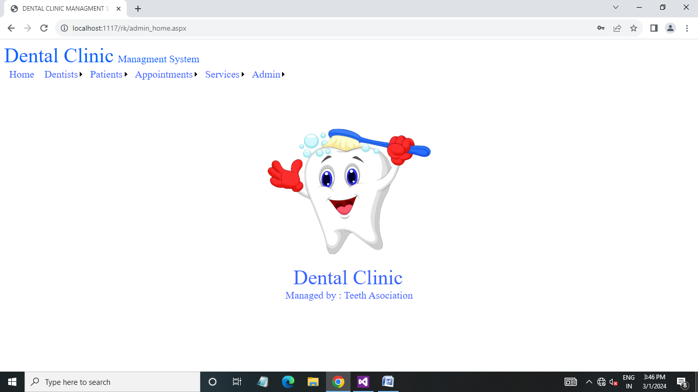
Admin Home page (Admin side) :

Slide 54
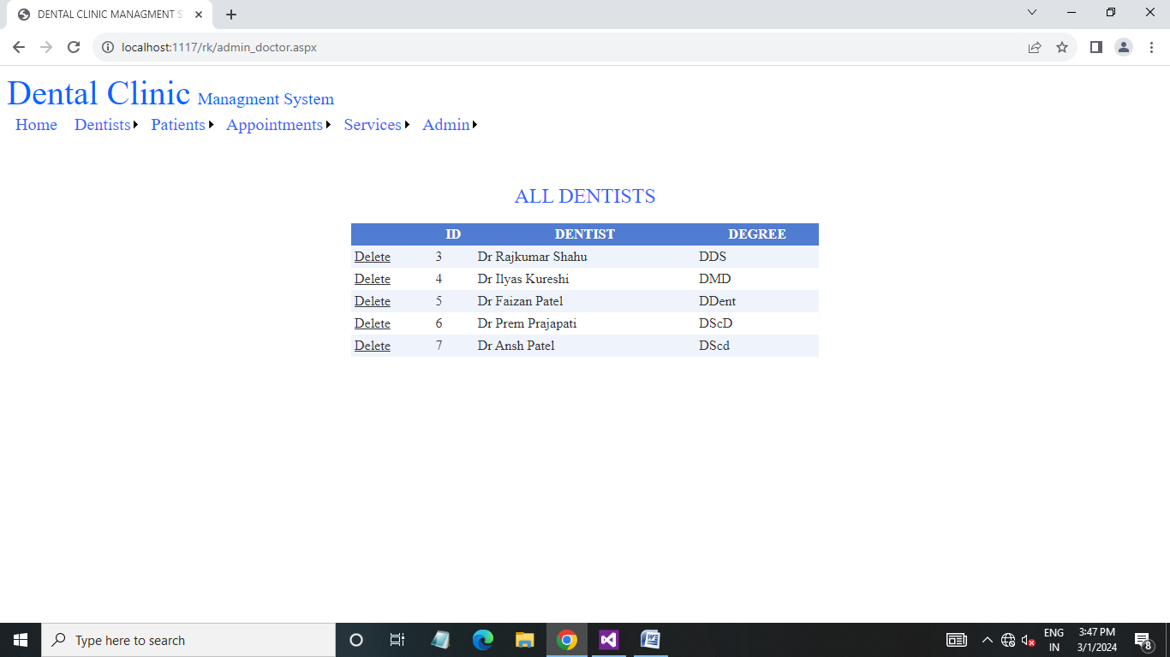
All Dentist list page (Admin side) :

Slide 55
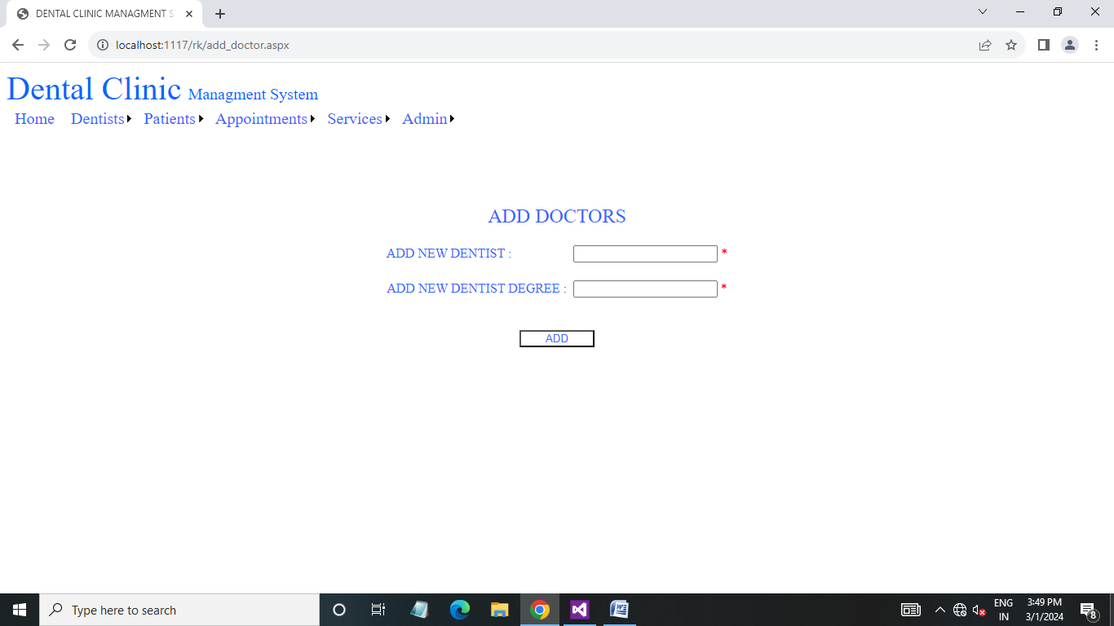
Add dentist page (Admin side) :

Slide 56

Add dentist page (Admin side) :

Slide 57
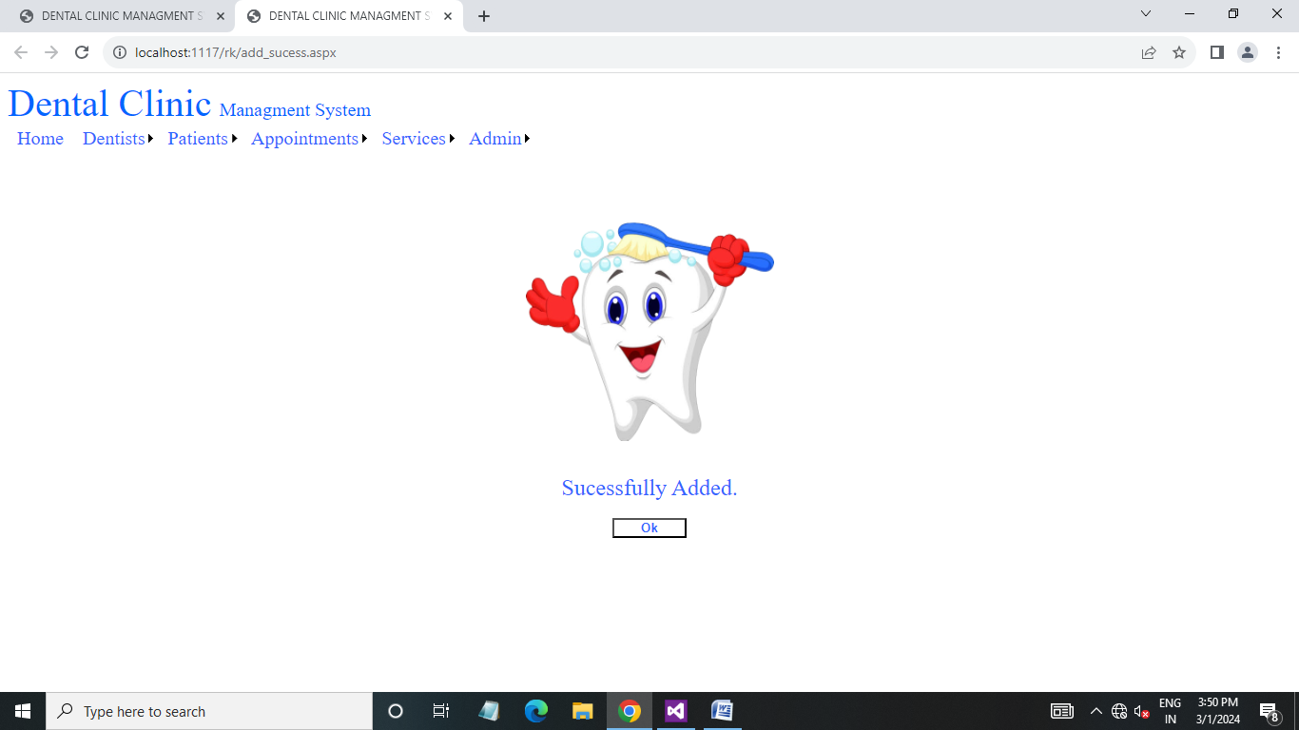
Add success page (Admin side) :

Slide 58
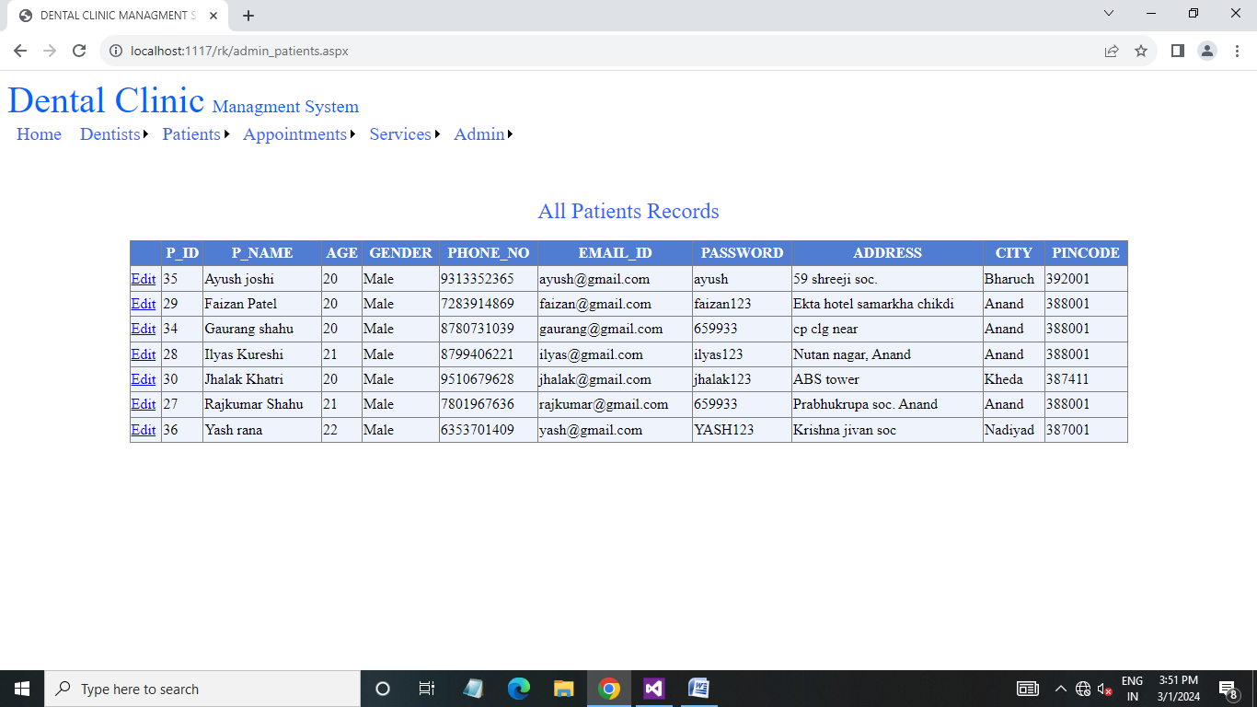
Patients list page (Admin side) :

Slide 59
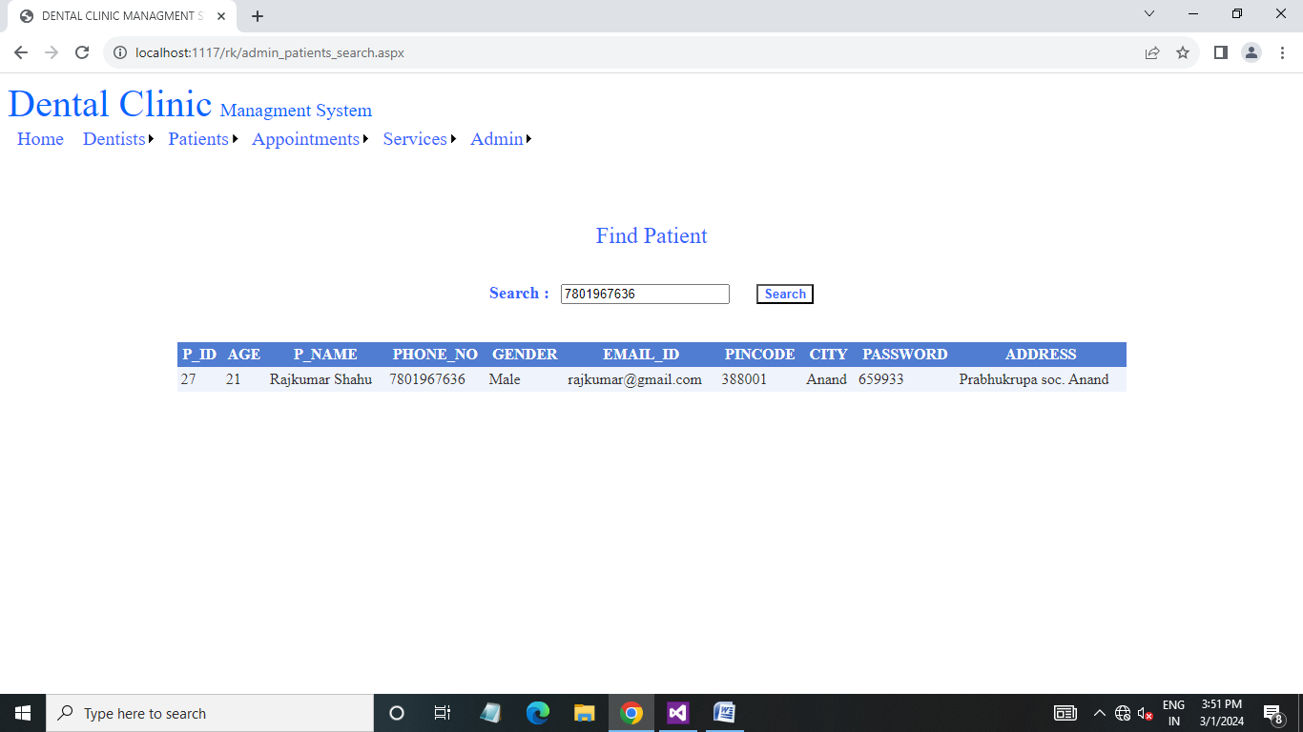
Find patient page (Admin side) :

Slide 60
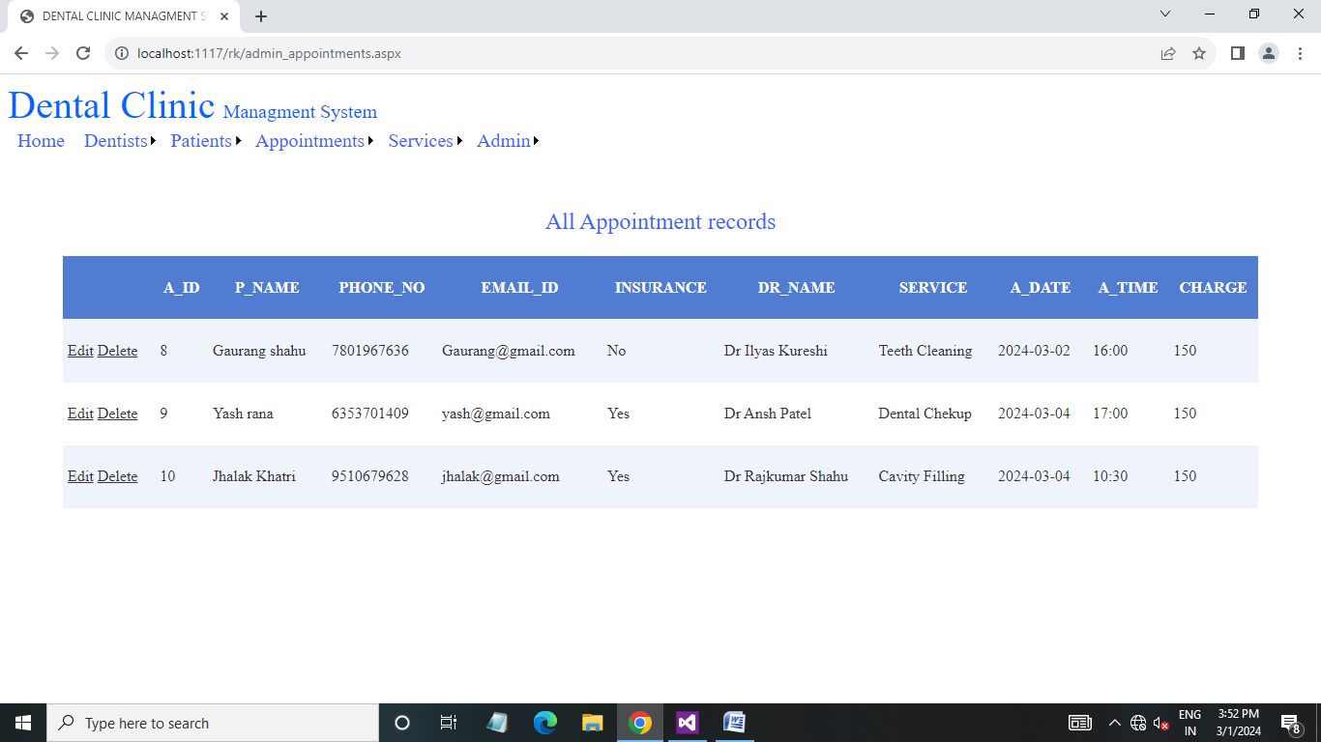
Appointment list page (Admin side) :

Slide 61
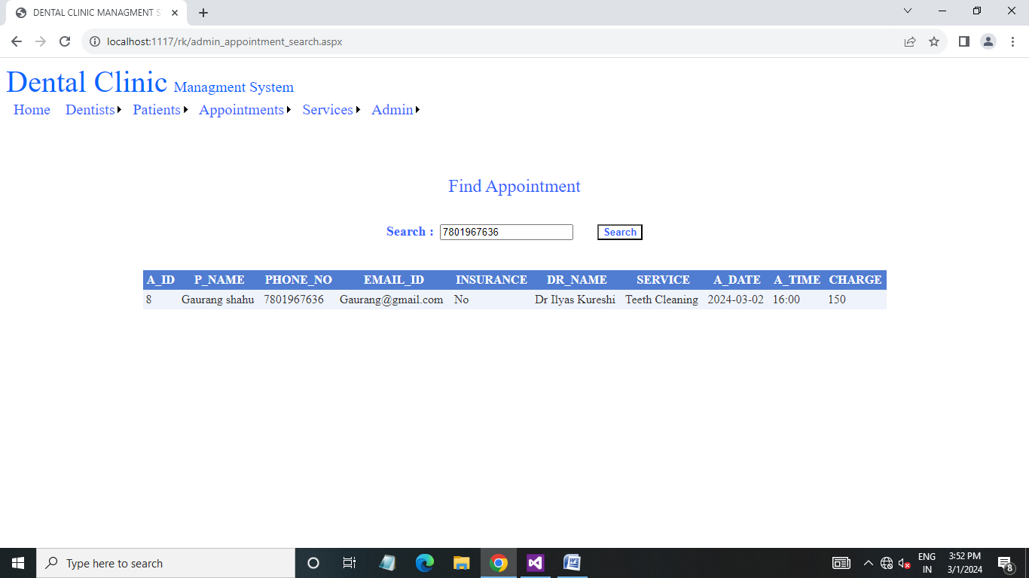
Find appointment page (Admin side) :

Slide 62

Services list page (Admin side) :

Slide 63
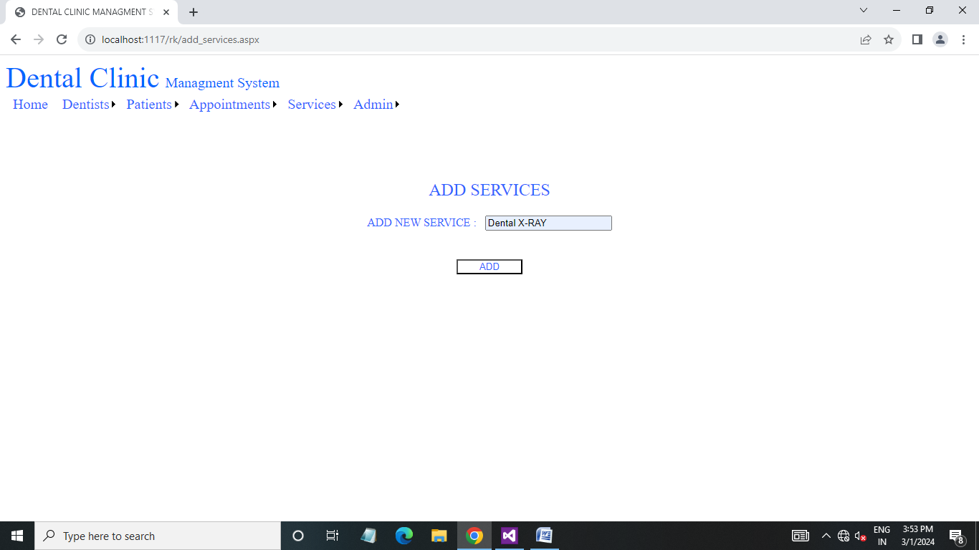
Add services page (Admin side) :

Slide 64
Add success page (Admin side) :

Slide 65
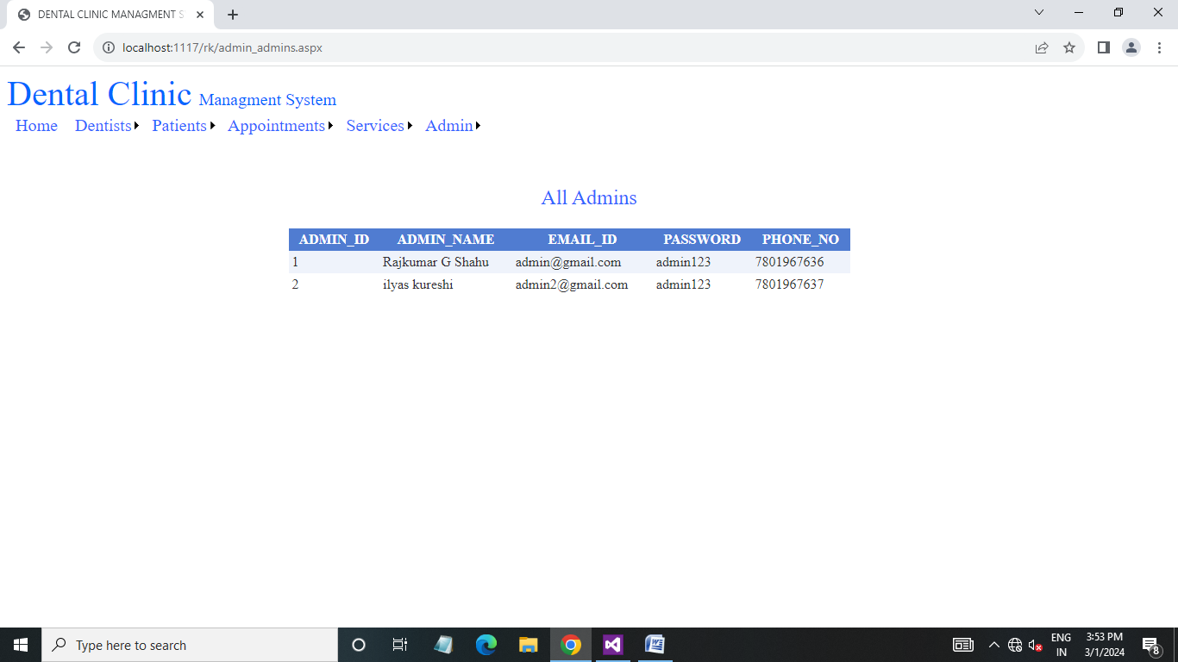
Admin list page (Admin side) :

Slide 66
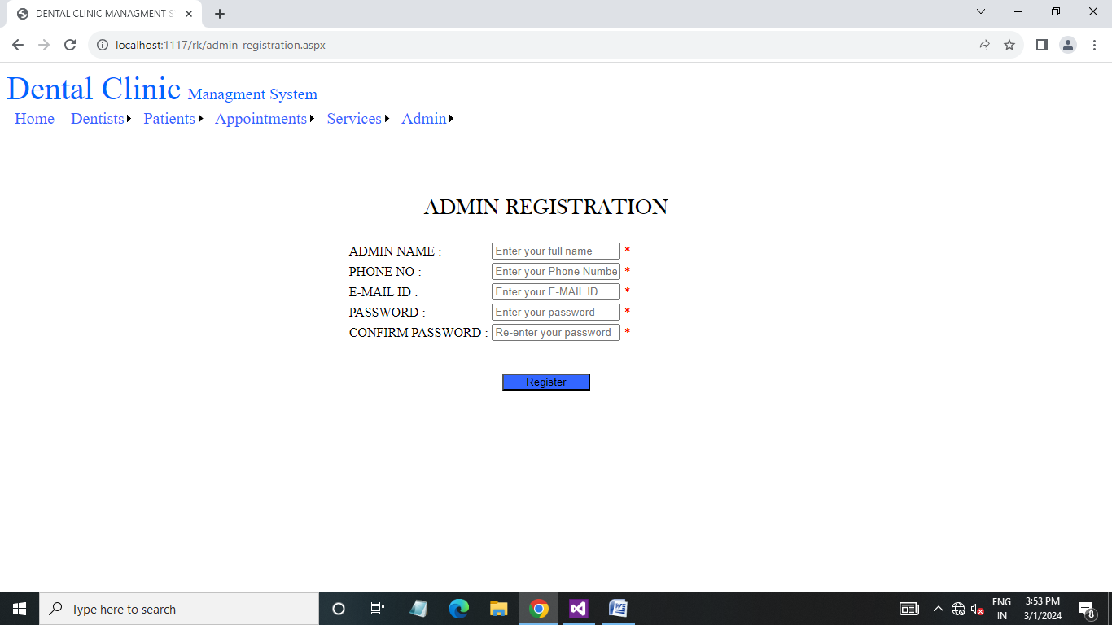
Home page (Patient side) :

Slide 67

New admin registration page (Admin side) :

Slide 68
Limitation :
Excel export has not been developed for dental clinic, doctor duo to some critically.
The transaction are executed in offline mode, hence online data for patient, text capture is not possible.
Offline reports of dental clinic, appointment, patient cannot be generated due to execution.
The user is provided help at each step for his convenience in working with the software punctuality of time was also major constraint thus it was not possible to make the software full proof and dynamic.

Slide 69
Proposed enhancement :
The developed system is client server application it can be ported on the web in the later stages of development.
The dental clinic system currently runs on the windows platform only. In the future enhancement the system can be ported on the other platforms.

Slide 70
Conclusion :
Our project is only a humble venture to satisfy the needs to manager their project work. The objective of software planning i9s to provide a frame work that enables the manager to make reasonable estimates made within a limited time frame at the beginning of the software project and should be updated regularly as the project progresses.

Slide 71

Clean Teeth, Strong Teeth Thank You

